Slide 1
Introduction to Databases (Postgres)
Zeyad Ashraf

Slide 2
Agenda
01
02
04
06
Subquery
Transaction
03
View
Functions
Trigger
05
Index
07
Users
Inheritance
08
09
Backup

Slide 3
Subqueries
A query inside another query.
Used in WHERE, FROM, or SELECT.
Example :
SELECT name
FROM customers
WHERE id IN (
SELECT customer_id
FROM orders
WHERE total > 1000
);

Slide 4
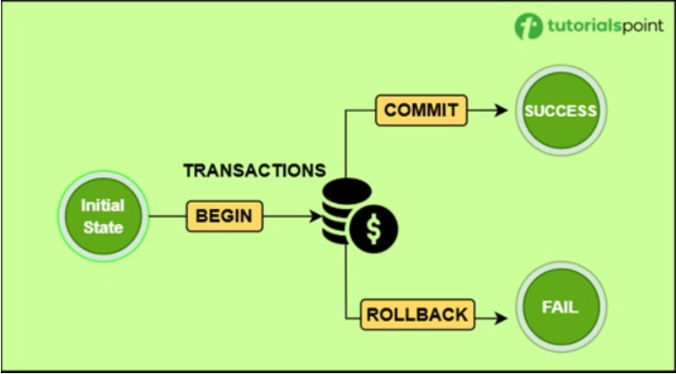
Transaction
A logical unit of work that uses SQL queries to combine one or more database operations. These operations shows the sequences like INSERT, UPDATE, DELETE, or SELECT. When executing multiple queries as a transaction, proper error handling is required for maintaining data integrity.

Slide 5
Transaction
Syntax :
BEGIN;
-- SQL statements
COMMIT; -- to save changes
ROLLBACK; -- to undo changes (if needed)
Example:
BEGIN;
UPDATE accounts
SET balance = balance - 500
WHERE account_id = 1;
UPDATE accounts
SET balance = balance + 500
WHERE account_id = 2;
COMMIT;

Slide 6
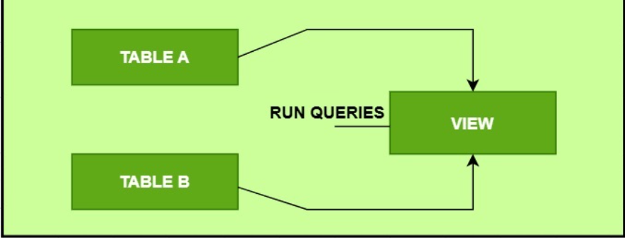
VIEWS
A view can contain all rows of a table or selected rows from one or more tables. A view can be created from one or many tables, which depends on the written PostgreSQL query to create a view.

Slide 7
View
Syntax :
BEGIN;
-- SQL statements
COMMIT; -- to save changes
ROLLBACK; -- to undo changes (if needed)
Example:
CREATE VIEW expensive_products AS
SELECT product_name, price
FROM products
WHERE price > 100;

Slide 8
VIEWS
Rules for Performing Operations on Views
(View must NOT contain)
GROUP BY, HAVING
Aggregate functions like SUM(), AVG(), COUNT()
DISTINCT or UNION
JOIN or Subqueries (in many cases)
Calculated (computed) columns (e.g., price * quantity)
Multiple base tables (must reference only one table)
Missing NOT NULL columns (for INSERT)

Slide 9
Functions
Also known as Stored Procedures, allow you to carry out operations that would normally take several queries and round trips in a single function within the database. Functions allow database reuse as other applications can interact directly with your stored procedures instead of a middle-tier or duplicating code.
Syntax :
Example:
CREATE [OR REPLACE] FUNCTION function_name (arguments)
RETURNS return_type AS $$
DECLARE
-- variable declarations
BEGIN
-- function logic
RETURN value;
END;
$$ LANGUAGE plpgsql;
CREATE OR REPLACE FUNCTION get_product_name(p_id INT)
RETURNS VARCHAR AS $$
DECLARE
prod_name VARCHAR;
BEGIN
SELECT product_name INTO prod_name
FROM products
WHERE product_id = p_id;
RETURN prod_name;
END;
$$ LANGUAGE plpgsql;

Slide 10
Triggers
Database callback functions, which are automatically performed/invoked when a specified database event occurs.
Syntax :
Example:
CREATE TRIGGER trigger_name
[BEFORE | AFTER | INSTEAD OF] {INSERT | UPDATE | DELETE}
ON table_name
FOR EACH ROW
EXECUTE FUNCTION function_name();
CREATE OR REPLACE FUNCTION log_price_change()
RETURNS TRIGGER AS $$
BEGIN
INSERT INTO price_logs(product_id, old_price, new_price, change_time)
VALUES (
OLD.product_id,
OLD.price,
NEW.price,
NOW()
);
RETURN NEW;
END;
$$ LANGUAGE plpgsql;

Slide 11
Indexes
Indexes are special lookup tables that the database search engine can use to speed up data retrieval. Simply put, an index is a pointer to data in a table. An index in a database is very similar to an index in the back of a book.
Syntax :
CREATE INDEX index_name
ON table_name (column_name);
Example:
CREATE INDEX idx_product_name
ON products (product_name);

Slide 12
Privladges

Slide 13
GRANT
Used to give users or roles specific permissions on database objects. Controls who can SELECT, INSERT, UPDATE, DELETE, etc.Can apply to tables, views, sequences, databases, etc.
Syntax :
GRANT privilege [, ...]
ON object [, ...]
TO { PUBLIC | GROUP group | username };
Example:
GRANT SELECT, INSERT
ON products
TO john;

Slide 14
REVOKE
Used to remove previously granted privileges from users or roles.
Helps maintain data security and limit access.
Opposite of the GRANT statement.
Syntax :
REVOKE privilege [, ...]
ON object [, ...]
FROM { PUBLIC | GROUP groupname | username };
Example:
REVOKE INSERT
ON products
FROM john;

Slide 15
Backup &Restore

Slide 16
Backup & Restore
Backup: Copy of your database saved to a file, to prevent data loss.
Restore: Reloading your database from a backup file, used in case of failure or migration.
Why it's important:
Protection from:
System crashes
Accidental deletion
Data corruption
Server migration

Slide 17
Backup
Syntax :
pg_dump dbname > backup_file.sql
Example:
pg_dump mydb > mydb_backup.sql
GUI Alternative: Use pgAdmin > Right-click DB > "Backup…"(Choose format, filename, path)

Slide 18
Restore
Syntax :
psql dbname < backup_file.sql
Example:
psql mydb < mydb_backup.sql
GUI (pgAdmin) also supports restoring via right-click > "Restore…"

Slide 19
What Is Inheritance ?
PostgreSQL allows a table to inherit columns from one or more parent tables.
Useful for modeling hierarchical data (e.g., base table for common fields, child tables for specific types).
Similar to OOP inheritance in concept.

Slide 20
INHERITS
Syntax :
CREATE TABLE child_table (
additional_columns
) INHERITS (parent_table);
Example:
Parent Table
Child Table
Insert Stmt
CREATE TABLE vehicles (
id SERIAL PRIMARY KEY,
brand VARCHAR,
model VARCHAR
);
CREATE TABLE cars (
doors INT
) INHERITS (vehicles);
INSERT INTO cars (brand, model, doors)
VALUES ('Toyota', 'Corolla', 4);

Slide 21
Important Notes On Inheritance!
Can select from parent to get all inherited rows:
SELECT from the parent table includes rows from child tables by default.
You can use only parent table to exclude child rows.
Inheritance doesn't support foreign keys between parent and child.
Not widely used — modern practice prefers partitioning or app-level logic.
SELECT * FROM vehicles;

Slide 22
Thanks
zeyadashraf015@gmail.com
01097143595
Zeyad Elmalky

